Slide 1
Oracle Database high availability from client perspective
Priit Piipuu

Slide 2
WHOAMI: Priit Piipuu
Started as a DBA twenty years ago, still OCP (11g)
Now gone over to the dark side, database developer in Kindred Group
Main job is to help developers use Oracle technologies in best way possible
© Kindred Group plc 2017
2

Slide 3


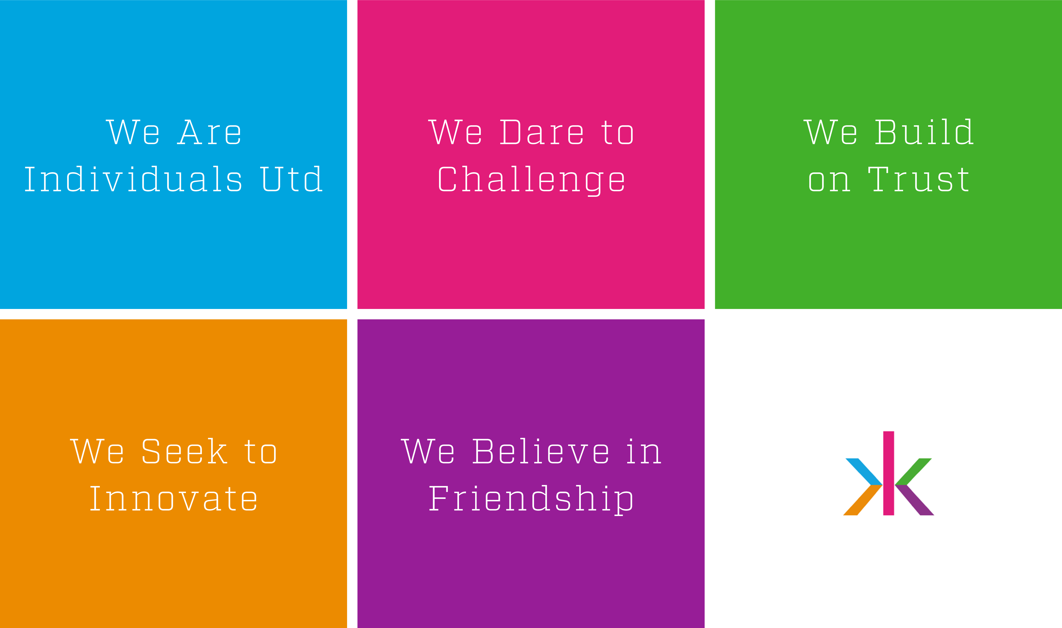
Our
Culture
&
Values
© Kindred Group plc 2017

Slide 4

Our brands
A portfolio of brands within sportsbook, casino and games
© Kindred Group plc 2017

Slide 5
Agenda
Threats against application high availability
Why this presentation, isn’t buying RAC enough?
What tools are available?
The acronyms:
TAF: Transparent Application Failover
FAN: Fast Application Notification
ONS: Oracle Notification Service
FCF + UCP: Fast Connection Failover and Universal Connection Pool
How it all fits together
What application sees during failover event
How things work in real world

Slide 6
Accidents happen
Node crashes, hardware failure, network and storage failure
Software crashes
Software bugs
User errors (Bobby Droptables)
Cosmic scale catastrophe that brings down the data centre
Notes:
We always seem to think about unplanned database downtime

Slide 7
Sometimes it's planned
Regular security patching, both OS and database!
Database upgrades. It is 2018 and Oracle STILL CANNOT do it in rolling mode!
Environment rebuilding:
Years pass, we all recognise some mistakes („legacy“) that require full environment rebuilds
Notes:
But don’t forget about planned downtime
Which one of them is more frequent in your environment?

Slide 8
Protection from data loss
Data Guard
Real time copy of your database
Not writable but can be opened for reading (Active DG, extra €)
Can be synchronous, or not
Role transitions can be automated (Fast Start Failover), offline for clients
Database operations are suspended during the transition
In 18c copy can be updatable, hiding role transitions
Can help with database upgrades with Logical Transient Standby
Notes:
Logical Transient Standby: Database operations are switched to standby, then primary database is upgraded, after that clients are switched back and standby can be upgraded

Slide 9
Service availability
RAC: Real Application Clusters
Single database serviced read/write by multiple instances
Strongly consistent
Can span over short distances (max 100km)
Application still connects to the single instance
In case of failure application needs to reconnect
Adding and removing instances is still disruptive
GDS: Global Data Services
Hiding configuration topology complexity from applications
Notes:
Adding and removing instances is disruptive, even during planned maintenance
AKA “RAC brownout”, needed to reorganise database buffer cache
Significantly improved in 12.2 using buddy instances
Complete freeze when instance fails, min 30 seconds + reconfiguration time
Helps with many planned maintenance scenarios, when can be done rolling in mode
Quarterly DB patching, OS patching, OS reconfiguration
Does not help for major database upgrades

Slide 10
Why this presentation?
We have implemented MAA, Oracle says we are now highly available.
Not true, Oracle gives you many tools to achieve availability,
You must use them properly.
True high availability is not possible without a little help from the client
Here we will see how the client side tools provided by Oracle work internally
And how to avoid mistakes we made (and I think we have not been alone)
Notes:
Great expectations:
Everything should be fast
Services should be always available
Google frontpage takes less than second to open and is always there. This sets expectations for the rest of the world. Customer does not care if you services are tad more complicated than static HTML. Implementing Oracle MAA does not mean everyone will live happily ever after: there's still things to do.
Role transitions and instance failovers are disruptive for clients

Slide 11
Why do we need failover in application layer
In case of failure in persistence layer, database clears up its mess. But!
In case of service/instance/node failure networking resources might not be gc’ed
Resolving networking timeouts takes time, up to 127s
Graceful failover in case of planned outages
Stale connections are retired gracefully
New connection attempts are sent to the surviving nodes
Extra features: connection load balancing and connection affinity
Notes:
UCP can detect and recreate broken connections if ValidateConnectionOnBorrow is set to true

Slide 12
Transparent Application Failover - TAF
Driver in application will detect database failure and reconnect silently
SELECT statements can be silently restarted
Transactions are lost
JDBC thin driver does not support TAF

Slide 13
Fast Application Notification (FAN)
Mechanism that notifies other processes about service configuration and status changes
Provides visibility into Oracle services, status messages can apply to services, instances or nodes
FAN status message is published immediately when state change occurs
Messages can be accessed either through
Oracle client (JDBC, UCP, OCI, ODP.NET),
FAN API
Server-side callouts
Supported by RAC, DataGuard and GDS
Needs Clusterware?

Slide 14
Fast Application Notification (II)
What FAN helps to avoid:
Waiting on TCP/IP timeouts if node fails to close the sockets or during subsequent connections when IP address is down
Attempts to connect service which is down
Not connecting when services resume
Processing the result in the client side when service goes down
Attempts to execute work on suboptimal nodes
Notes:
TCP connect timeout = 2^(tcp_syn_retries+1)-1
In RHEL 7 tcp_syn_retries = 6, so tcp connect timeout = 127
Oracle client will time out after 60 seconds (ORA12170: TNS: Connect timeout occurred)
In our Clusterware installations, best case for client to receive FAN messages are 10ms after the event, worst case is 500ms.

Slide 15
Oracle Notification Service
Propagates notifications between Oracle Clusterware and FAN client
Clients can subscribe for specific event types and/or services
With UCP 12.1.0.1 must be configured explicitly, can be massive configuration inflexiblity-pain
In UCP 12.2 ONS, FAN and FCF (Fast Connection Failover) are enabled automatically when appropriate
Notes:
ONS configuration: actually depends on ons.jar version, but versions should be same between all the components.

Slide 16
FAN messages: SERVICE METRICS example
Notification Type: database/event/servicemetrics/service.example.com
Affected Components: null
Affected Nodes: null
Delivery Time: 1527334439000
Generating Component: database/rac/service
Generating Node: node1.example.com
Generating Process: node1.example.com :15387
Notification ID: node1.example.com :15387:1521547213:0:959076
Notification Creation Time:1527334436000
Cluster ID: dbInstance_ node1.example.com _6200
Cluster Name: dbInstance_ node1.example.com _6200
Instance ID: dbInstance_ node1.example.com _6200
Instance Name: dbInstance_ node1.example.com _6200
Local Only Flag: FALSE
Body: [B@752325ad
Notes:
Notification type: one of NODE, INSTANCE, DATABASE, SERVICEMEMBER, SERVICE, SERVICE METRICS
Delivery/Notification Creation Time: in seconds after epoch, no milliseconds
Event statuses: UP, DOWN, NODEDOWN, NOT_RESTARTING
Event reasons:
USER (user initiated commands like srvctl, sqlplus or gdsctl)
FAILURE
MEMBER_LEAVE (node has gone offline)
PUBLIC_NW_DOWN (public network has gone offline)
BOOT (in case of node boot, DATABASE, INSTANCE or SERVICEMEMBER events will start with reason=BOOT)

Slide 17
Case study: Universal Connection Pool
Oracle provided JDBC connection pool implementing most of the High Availability features
Universal: supposed to work with all behaving drivers
Free to use
Supports many cool features
Sharding!
Acts as client for Fast Application Notification
Feature is called Fast Connection Failover (FCF)
Notes:
TODO: Use text for slides #29 .. #31 as additional talk, depending on listenrs.

Slide 18
Fast Connection Failover
Feature of UCP that uses FAN and ONS
UCP acts as FAN client, handles connections affected by failover or planned maintenance
Provides isValid API for error resolution.
Through oracle.ucp.jdbc.ValidConnection interface
Has QoS and workload balancing features.

Slide 19
FCF: how failover works
There's service interruption in database layer leaving stale connections in UCP cache.
Oracle Clusterware generates FAN event
Daemon thread in JVM
Receives the alert,
Finds affected connections and closes them, including physical connections to the database. Details differ in case of planned and unplanned outages.
Each borrowed connection receives SQLException and should either
Retry the connection request
Replay the transaction

Slide 20
FCF: handling the outages
Unplanned outages
Finds stale connection that do not have service available on any instance in cluster due to service/down or node/down events
Operates both on borrowed and available connections, kills physical connections
In case of borrowed connection, application receives exception
Connections are not replaced in the pool, application is supposed to retry
Planned outages
Stale borrowed connections are marked and will be aborted when returned to the pool
Does not affect any ongoing transactions
Main difference with unplanned outage is how borrowed connections are handled
There is graceful connection draining starting with 12.1.0.2,
oracle.ucp.PlannedDrainingPeriod

Slide 21
UCP: load balancing and connection affinity
Runtime connection rebalancing
Routes connections to the instance that has best performance available
Adjusts distribution of work based on different backend capabilities (CPU capacity or response time)
Reacts quickly to cluster reconfiguration, overworked nodes or hangs
Configured in server-side
Connection affinity
Allows connection pool to select connections that are directed to specific instance.
Transaction based affinity
Web session affinity
Needs callback to be created (callback as in Java class that implements ConnectionAffinityCallback interface)
Notes:
Connection affinity needs FCF and connection rebalancing

Slide 22
Road to availability: singleton services
Good:
Performance: no cluster waits
Bad:
Service relocation creates DOWN events for SERVICE and SERVICEMEMBER
UCP gets the message and does hard failover
All the sessions are terminated, and everything is dead until corresponding UP messages
Notes:
In our environment service relocation takes between few ms and a few hundred ms. There is race condition between service coming up in another node and UCP getting silly ideas about the failover.

Slide 23
Road to availability: uniform distribution
Bad:
Not-so-good for performance (cluster waits)
Good:
Planned outages do not cause major interruption
Ugly:
Is UCP receiving FAN messages? Is it taking action?
Badly behaving applications
Notes:
race in case of singleton services: before service becomes available and before connection pool reaps stale connections.

Slide 24
UCP in a real world
Only new connections are balanced, so set the timeouts
InactiveConnectionTimeout: how long available connections can be idle before being removed from the connection pool
MaxConnectionReuseTime: how long connection can be used before being gracefully removed from the pool
FAN events and actions are not logged by UCP, not even in debug level
How to monitor what’s going on?
Does Simplefan work?
FANwatcher for the rescue?

