Slide 1
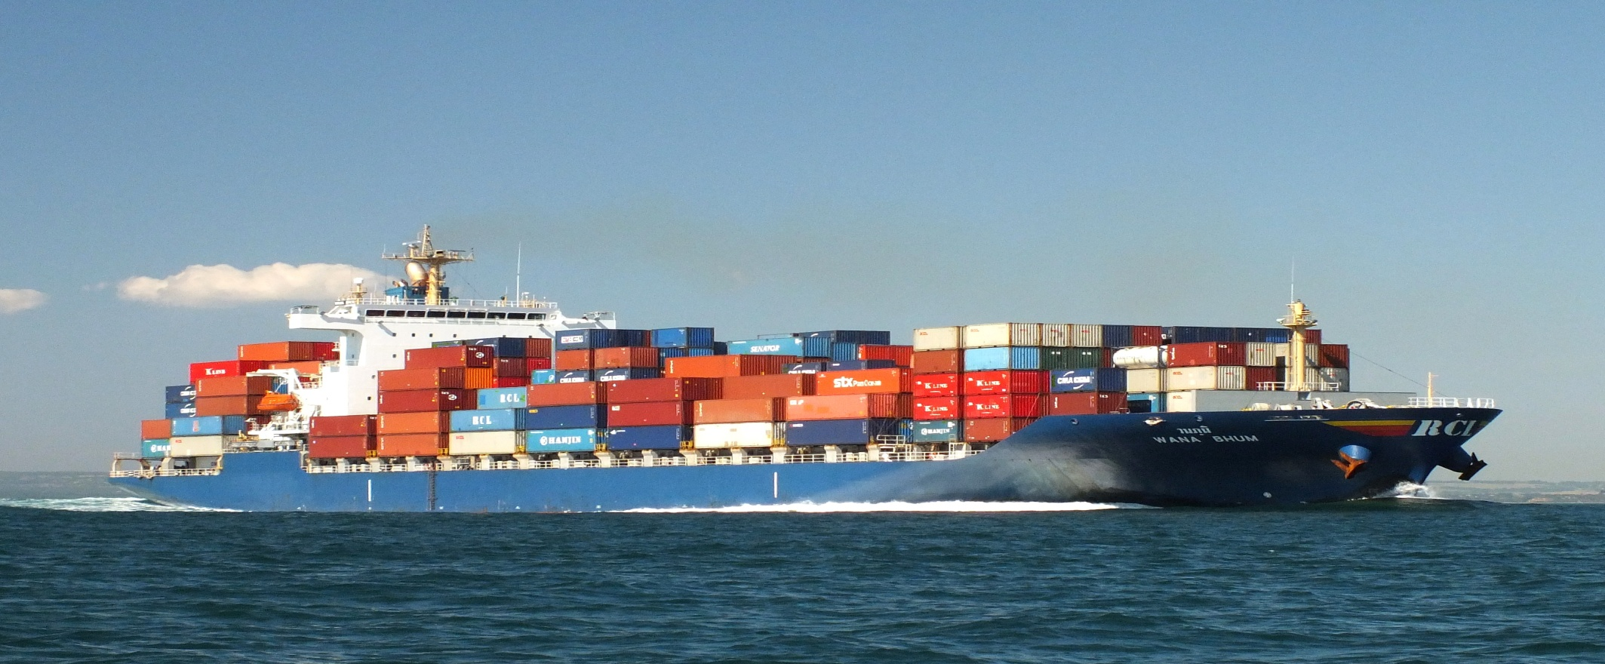




Oracle Container Cloud Service made easy HROUG Conference 2018
Short recipeS by ciprian onofreiciuc

Slide 2



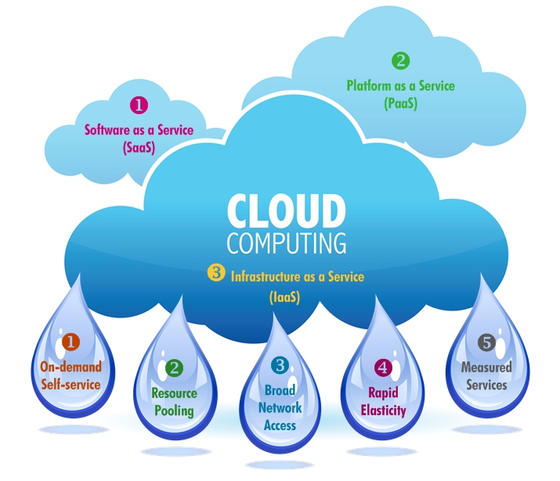

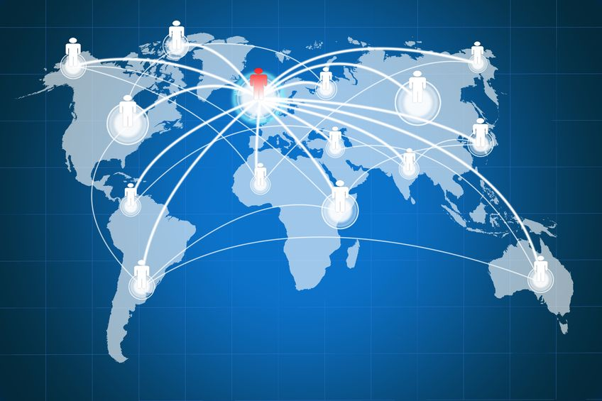
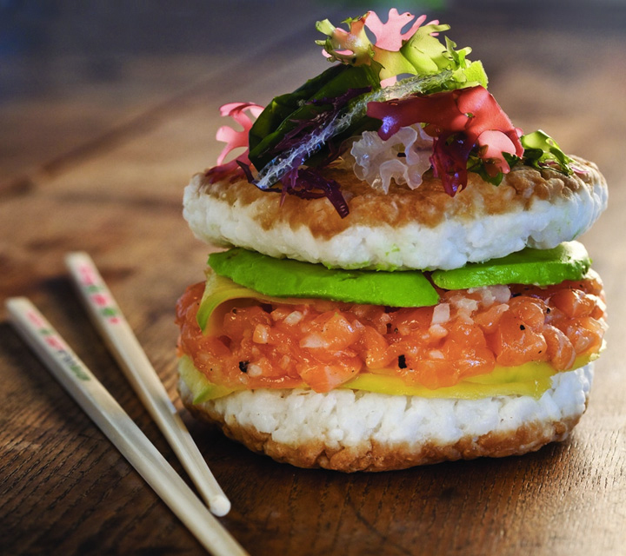
Acceleration
IT TRENDS , FOLLOW AND LEAD OTHER TRENDS
Scaling
Automation
Fusion
Connectivity
Globalization
Cloud Adoption
Notes:
Today IT landscape is full of changes and challenges. The velocity of change given by the adoption of technology by users.
In the last 20 years, there number of people using internet and technologies related almost doubled each 5 years, so in dec 2017 about 4.157 billion persons user internet https://www.internetworldstats.com/emarketing.htm
This pressure from the market has impact on technology so the development of information technology domain is direct related with the evolution of adoption.

Slide 3


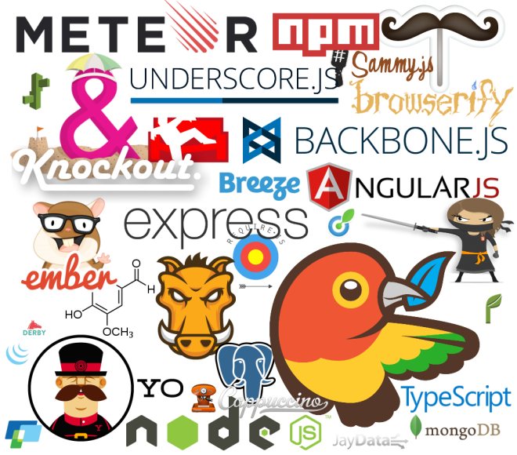
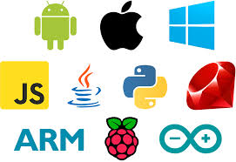
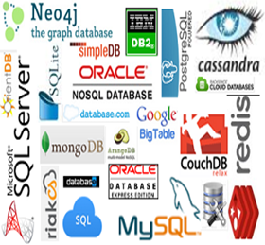
PROBLEM TODAY IT IS MORE LIKE TAKING LUNCH
Notes:
So today IT is more like taking lunch in a country that you don’t speak the language in a restaurant where menu is in local language and is changing every day
So what are the characteristics of a good lunch?
It needs to satisfy your necessities for nutrients
It needs to be healthy so at the end of the lunch you don’t arrive in hospital
It needs to be affordable
It needs to be tasty

Slide 4
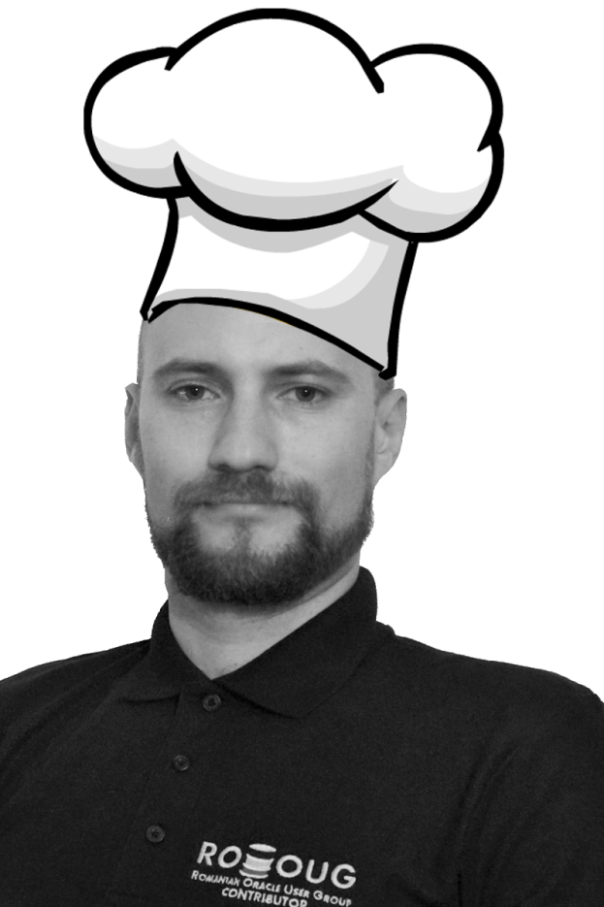

FOR GREAT EXPERIENCE WITH SERVICES RECOMMENDATION IS NEEDED
+17 years of experience in software development
+10 years of experience working with Oracle
+6 years of community experience in RoOUG
From 2016 experienced Enterprise Architect Certified Expert in SQL , PL/SQL, Linux, Business Intelligence and Oracle Architecture started a consulting company OCTET INTELLIGENCE

Slide 5
HOW TO RESPOND TO THIS FULL MENU TO SIMPLIFY IT?
Consolidation
Boxes Can Be Aggregated For Higher Purposes
Speed
Every BOX Should Be Moved Around Easily
Agility
Every BOX Can Change
Every BOX Should Be Used As A Building Block
Composition
Abstraction
Everything Is A BOX

Slide 6
Searching a Solution For an Edible Lunch?

Slide 7
Containers?
2014 Rocket
2013 LMCTFY
DOCKER
2011 Warden
2008 Linux Containers
2007 AIX (6.1) WPARS
cgroups in Linux Kernel (2.6.24)
2006 Process Containers
2005 Open VZ
2004 Oracle Solaris Containers
2001 Linux vServer
2000 FreeBSD Jails
1979 UNIX V7 added chroot
Notes:
Containers are not a new thing, but implementing them was always a little more complicated than it needed to be.
1979 NoDuring the development of Unix V7 in 1979, the chroot system call was introduced, changing the root directory of a process and its children to a new location in the filesystem. This advance was the beginning process isolation: segregating file access for each process.
2000 FreeBSD Jails allows administrators to partition a FreeBSD computer system into several independent, smaller systems – called “jails” – with the ability to assign an IP address for each system and configuration.
2001 , Linux VServer is a jail mechanism that can partition resources (file systems, network addresses, memory) on a computer system. Introduced in 2001, this operating system virtualization that is implemented by patching the Linux kernel.
2004 Oracle released a Solaris Container that combines system resource controls and boundary separation provided by zones, which were able to leverage features like snapshots and cloning from ZFS.
OPEN VZ This is an operating system-level virtualization technology for Linux which uses a patched Linux kernel for virtualization, isolation, resource management and checkpointing. The code was not released as part of the official Linux kernel.
2006 - Process Containers (launched by Google in 2006) was designed for limiting, accounting and isolating resource usage (CPU, memory, disk I/O, network) of a collection of processes.
2007 AIX 6.1 allows virtualization without creating a full LPAR
Process containers were renamed “Control Groups (cgroups and eventually merged to Linux kernel 2.6.24.
2008 LXC (LinuX Containers) was the first, most complete implementation of Linux container manager. It was implemented in 2008 using cgroups and Linux namespaces, and it works on a single Linux kernel without requiring any patches.
2011 CloudFoundry started Warden in 2011, using LXC in the early stages and later replacing it with its own implementation. Warden can isolate environments on any operating system, running as a daemon and providing an API for container management. It developed a client-server model to manage a collection of containers across multiple hosts, and Warden includes a service to manage cgroups, namespaces and the process life cycle.
2013 LMCTFY Let Me Contain That For You (LMCTFY) kicked off in 2013 as an open-source version of Google's container stack, providing Linux application containers. Applications can be made “container aware,” creating and managing their own subcontainers. Active deployment in LMCTFY stopped in 2015 after Google started contributing core LMCTFY concepts to libcontainer, which is now part of the Open Container Foundation.
2013 DOCKER , started based on LXC in its initial stages and later replaced that container manager with its own library, libcontainer. Docker separated itself from the pack by offering an entire ecosystem for container management.

Slide 8
Containers? (I)
2013
DOCKER
2014
Rocket
2013
LMCTFY
2011
Warden
2007
AIX (6.1) WPARS
2008 Linux Containers
2006 Process Containers
2007
cgroups in Linux Kernel (2.6.24)
2005
Open VZ
2001
Linux vServer
2000
FreeBSD Jails
1979
UNIX V7 added chroot
2004
Oracle Solaris Containers
Notes:
Containers are not a new thing, but implementing them was always a little more complicated than it needed to be.
1979 NoDuring the development of Unix V7 in 1979, the chroot system call was introduced, changing the root directory of a process and its children to a new location in the filesystem. This advance was the beginning process isolation: segregating file access for each process.
2000 FreeBSD Jails allows administrators to partition a FreeBSD computer system into several independent, smaller systems – called “jails” – with the ability to assign an IP address for each system and configuration.
2001 , Linux VServer is a jail mechanism that can partition resources (file systems, network addresses, memory) on a computer system. Introduced in 2001, this operating system virtualization that is implemented by patching the Linux kernel.
2004 Oracle released a Solaris Container that combines system resource controls and boundary separation provided by zones, which were able to leverage features like snapshots and cloning from ZFS.
OPEN VZ This is an operating system-level virtualization technology for Linux which uses a patched Linux kernel for virtualization, isolation, resource management and checkpointing. The code was not released as part of the official Linux kernel.
2006 - Process Containers (launched by Google in 2006) was designed for limiting, accounting and isolating resource usage (CPU, memory, disk I/O, network) of a collection of processes. It was renamed “Control Groups (cgroups)” a year later and eventually merged to Linux kernel 2.6.24.
2008 LXC (LinuX Containers) was the first, most complete implementation of Linux container manager. It was implemented in 2008 using cgroups and Linux namespaces, and it works on a single Linux kernel without requiring any patches.
2011 CloudFoundry started Warden in 2011, using LXC in the early stages and later replacing it with its own implementation. Warden can isolate environments on any operating system, running as a daemon and providing an API for container management. It developed a client-server model to manage a collection of containers across multiple hosts, and Warden includes a service to manage cgroups, namespaces and the process life cycle.
2013 LMCTFY Let Me Contain That For You (LMCTFY) kicked off in 2013 as an open-source version of Google's container stack, providing Linux application containers. Applications can be made “container aware,” creating and managing their own subcontainers. Active deployment in LMCTFY stopped in 2015 after Google started contributing core LMCTFY concepts to libcontainer, which is now part of the Open Container Foundation.
2013 DOCKER , started based on LXC in its initial stages and later replaced that container manager with its own library, libcontainer. Docker separated itself from the pack by offering an entire ecosystem for container management.

Slide 9

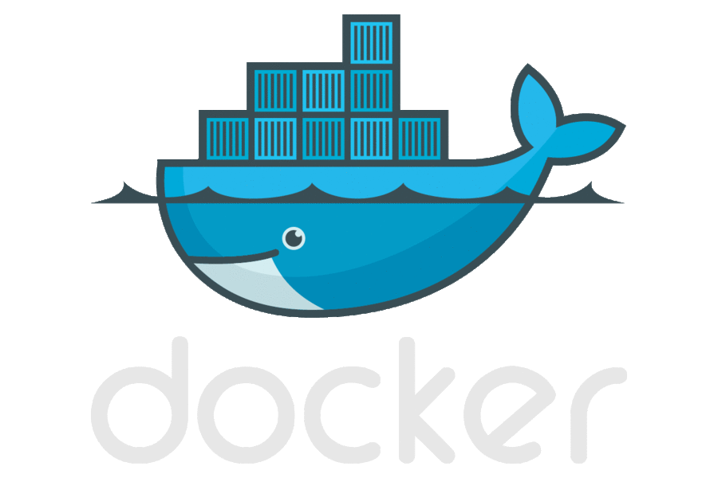
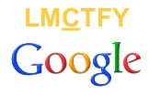

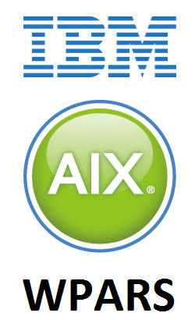


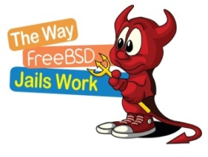

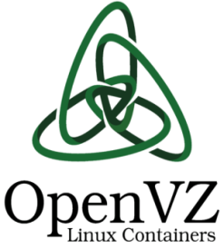
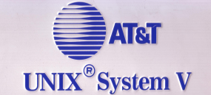
Containers? (II)

Slide 10
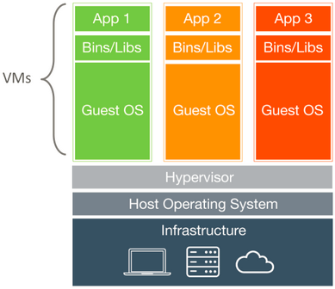
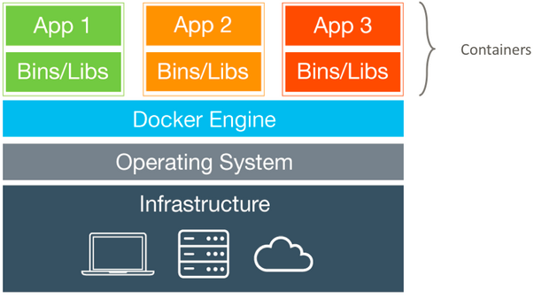
Containers? (III)
Virtual Machines
Containers
Each virtual machine (VM) include the app, the necessary binaries and libraries and an entire guest operating system
Containers include the app & all of its dependencies, but share the kernel with other containers
Runs as isolated process in userspace on the host OS
Not tied to any specific infrastructure – containers run on any computer infrastructure and cloud
Notes:
Windows and Linux containers require that they run on their respective kernel base, therefore, Windows containers cannot run on Linux hosts and vice versa.
Docker images are a collection of files, which have everything needed to run the software application inside the container. However, they are ephemeral, meaning that any data that is written inside the container, while it is running, will not be retained.
If the container is stopped and restarted from its image, the container will run exactly the same as the first time, absent of any changes made during the last run cycle. Changes to the container either have to be made during the image creation process, using the Dockerfile that become part of the image, or data can be retained by mounting a persistent storage volume, from inside the container to the outside. This will be explored further in the HOL exercises below.

Slide 11

Docker?

Slide 12
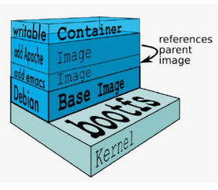
Docker? (I)
Docker - a virtual container based on layers applied over and over to obtain the desired box. Layers are images read-only applied to an base image file.
As actions are done to a Docker base image, union file system layers are created and documented, such that each layer fully describes how to recreate an action. This strategy enables Docker's lightweight images, as only layer updates need to be propagated (compared to full VMs, for example).
If the container is stopped and restarted from its image, the container will run exactly the same as the first time, absent of any changes made during the last run cycle. Changes to the container either have to be made during the image creation process, using the Dockerfile that become part of the image, or data can be retained by mounting a persistent storage volume, from inside the container to the outside.
Notes:
Docker images are a collection of files, which have everything needed to run the software application inside the container. However, they are ephemeral, meaning that any data that is written inside the container, while it is running, will not be retained.
If the container is stopped and restarted from its image, the container will run exactly the same as the first time, absent of any changes made during the last run cycle. Changes to the container either have to be made during the image creation process, using the Dockerfile that become part of the image, or data can be retained by mounting a persistent storage volume, from inside the container to the outside. This will be explored further in the HOL exercises below.

Slide 13
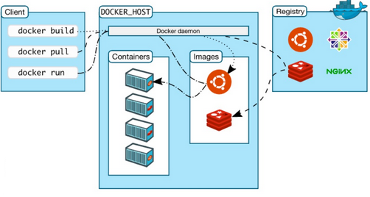
Docker? (terminology)
Docker Engine is THE core piece of technology that allows you to run containers. In order for a container to run on any Linux host, at a minimum, the Docker Engine needs to be installed. Then the container can run on any Linux host where Docker Engine is installed, providing the benefit of portability, without doing any application specific configuration changes on each host.
Dockerfile the text file of Docker instruction used to assemble a Docker Image
Image hierarchies of files built from a Dockerfile, the file used as input to the docker build command
Container running instance of an Image using the docker run command
Docker Composer tool for defining and running multi-container Docker applications.
Docker Client – Command line interface (CLI) for interfaceing with the Docker
Registry – Image repository
Notes:
Docker images are a collection of files, which have everything needed to run the software application inside the container. However, they are ephemeral, meaning that any data that is written inside the container, while it is running, will not be retained.
If the container is stopped and restarted from its image, the container will run exactly the same as the first time, absent of any changes made during the last run cycle. Changes to the container either have to be made during the image creation process, using the Dockerfile that become part of the image, or data can be retained by mounting a persistent storage volume, from inside the container to the outside. This will be explored further in the HOL exercises below.

Slide 14
Docker? (architecture)

Slide 15
Docker? (IV)
Advantages for Developers:
Quickly create ready-to-run packaged applications, with low cost of deployment and replay
Automate testing, integration, packing
Reduce/eliminate platform compatibilities issues (“it works on dev!”)
Supports next-generation application on microservices
Advantages for Operations:
Improve speed and frequency of releases, reliability of deployments
Makes application lifecycle efficient, consistent and repeatable – configure once, run many times
Eliminate environment inconsistencies between development, test, production
Improve production application resiliency and scale out /in on demand
Notes:
Docker images are a collection of files, which have everything needed to run the software application inside the container. However, they are ephemeral, meaning that any data that is written inside the container, while it is running, will not be retained.
If the container is stopped and restarted from its image, the container will run exactly the same as the first time, absent of any changes made during the last run cycle. Changes to the container either have to be made during the image creation process, using the Dockerfile that become part of the image, or data can be retained by mounting a persistent storage volume, from inside the container to the outside. This will be explored further in the HOL exercises below.

Slide 16

Docker? (V)
“Docker builds upon concepts of the past but packages them better.”
@ChrisChinch
Rich ecosystem
Contributors The Docker team, Cisco, Google, Huawei, IBM, Microsoft, and Red Hat.
Docker Hub Repository with 100.000+ applications
GitHub Integration with GitHub ensures extensions
Commercial
Repositories Bitnami, Jfrog Artifactory, Amazon EC2 Container Registry
Notes:
Docker images are a collection of files, which have everything needed to run the software application inside the container. However, they are ephemeral, meaning that any data that is written inside the container, while it is running, will not be retained.
If the container is stopped and restarted from its image, the container will run exactly the same as the first time, absent of any changes made during the last run cycle. Changes to the container either have to be made during the image creation process, using the Dockerfile that become part of the image, or data can be retained by mounting a persistent storage volume, from inside the container to the outside. This will be explored further in the HOL exercises below.

Slide 17
How? (on premises)
On premises (Windows/Linux OS)
Verifing installation of Docker package programs
$> docker –version => Docker version 1.1x.x, build 57bf6fd
Obtain a Docker image from any docker repositories
$> docker pull karthequian/helloworld:latest
Run Docker instance based on the image file
$>docker run -d --name helloworldapp -p 80:80/tcp "karthequian/helloworld:latest"
List Docker instances running
$> docker ps
Stop container
$> docker stop helloworld_app
Delete Container
$> docker rm helloworld_app
Notes:
Docker images are a collection of files, which have everything needed to run the software application inside the container. However, they are ephemeral, meaning that any data that is written inside the container, while it is running, will not be retained.
If the container is stopped and restarted from its image, the container will run exactly the same as the first time, absent of any changes made during the last run cycle. Changes to the container either have to be made during the image creation process, using the Dockerfile that become part of the image, or data can be retained by mounting a persistent storage volume, from inside the container to the outside. This will be explored further in the HOL exercises below.

Slide 18
How? (on premises)
Build you own Docker Image Localy
Creating a empty file
$> cd mydockerbuild
$> vi Dockerfile
Edit file
FROM docker/whalesay:latest
RUN apt-get -y update && apt-get install -y fortunes
CMD /usr/games/fortune -a | cowsay
Build Docker image
$ docker build -t docker-whale .
Run docker image
$ docker run docker-whale
Push image to Docker Hub
$> docker login
$> docker tag docker-whale:latest username/docker-whale:latest
$> docker push username/docker-whale:latest
Notes:
Docker images are a collection of files, which have everything needed to run the software application inside the container. However, they are ephemeral, meaning that any data that is written inside the container, while it is running, will not be retained.
If the container is stopped and restarted from its image, the container will run exactly the same as the first time, absent of any changes made during the last run cycle. Changes to the container either have to be made during the image creation process, using the Dockerfile that become part of the image, or data can be retained by mounting a persistent storage volume, from inside the container to the outside. This will be explored further in the HOL exercises below.

Slide 19
How? (OCCS)
Oracle Container Cloud Service
Get Oracle Cloud Access – Free Credits
Create a container instance
Import your container application in Oracle Container Cloud Service
Start Container
Manage Container
Notes:
Docker images are a collection of files, which have everything needed to run the software application inside the container. However, they are ephemeral, meaning that any data that is written inside the container, while it is running, will not be retained.
If the container is stopped and restarted from its image, the container will run exactly the same as the first time, absent of any changes made during the last run cycle. Changes to the container either have to be made during the image creation process, using the Dockerfile that become part of the image, or data can be retained by mounting a persistent storage volume, from inside the container to the outside. This will be explored further in the HOL exercises below.

Slide 20
Best Practices – Oracle Cloud Container Service
Creating private repositories
Start from platform ready Docker image file
Mettered Vs Non Mettered
Sizing

Slide 21
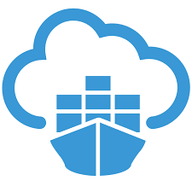
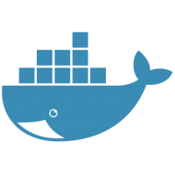
Conclusion?
Oracle Cloud Container Service &
Doker
Consolidation
Oracle Cloud Container Service &
Doker
Speed
Agility
Doker
Composition
Docker
Abstraction
Docker

Slide 22
Q & A
reFERENCES:
https://cloud.oracle.com/container-classic
https://cloud.oracle.com/iaas/ebooks/Oracle_Container_Cloud_Service.pdf
https://github.com/oracle/cloud-native-devops-workshop/blob/master/containers/docker001/Participant-Guide.md
http://www.oracle.com/technetwork/articles/cloudcomp/munz-docker-occs-3585210.html
http://www.oracle.com/webfolder/technetwork/tutorials/obe/cloud/container_cloud/creating_an_occs_service_instance/creating_occs_instance.html
Contact
http://OCTET.CLOUD | HTTP://ROOUG.RO
ciprian@octet.cloud |ciprian@rooug.ro

Slide 23
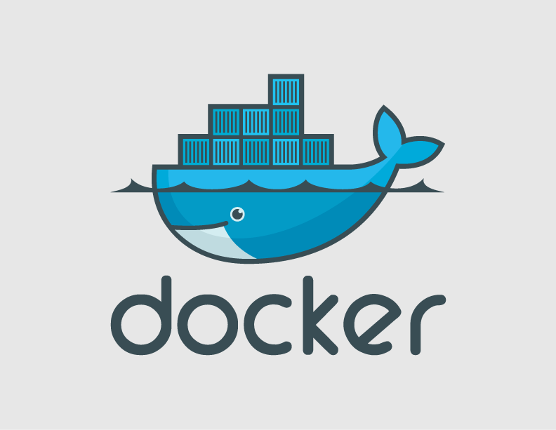
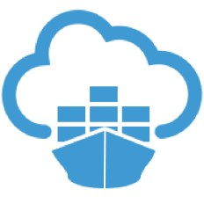
Lunch?

